Slide 1
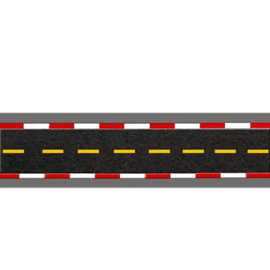
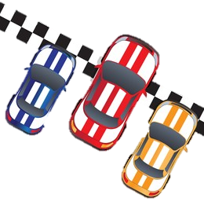
CAR RACING GAME
START

Slide 2




Car Racing Game
Car Racing Game
Move
Move

Slide 3


Questions
1
2
3
4
7
8
5
6

Slide 4
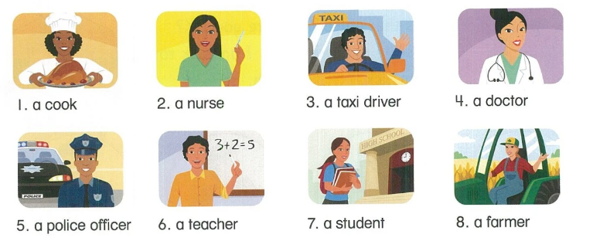
Question No. 1
Who’s he?
See Answer

Slide 5
Answer No. 1
She’s a cook.
Return to Race

Slide 6
Question No. 2
Who’s she?
See Answer

Slide 7
Answer No. 2
She’s a nurse.
Return to Race

Slide 8
Question No. 3
Who’s he?
See Answer

Slide 9
Answer No. 3
He’s a taxi driver.
Return to Race

Slide 10
Question No. 4
Who’s she?
See Answer

Slide 11
Answer No. 4
She’s a doctor.
Return to Race

Slide 12
Question No. 5
Who’s he?
See Answer

Slide 13
Answer No. 5
He’s a police officer.
Return to Race

Slide 14
Question No. 6
Who’s he?
See Answer

Slide 15
Answer No. 6
He’s a teacher.
Return to Race

Slide 16
Question No. 7
Who’s she?
See Answer

Slide 17
Answer No. 7
She’s a student.
Return to Race

Slide 18
Question No. 8
Who’s she?
See Answer

Slide 19
Answer No. 8
She’s a farmer.
Return to Race

